Slide 1
CLIENT NAME LEARNING MANAGEMENT SYSTEM IMPLEMENTATION
Project Kickoff Meeting
January 9th – 10th 2018

Slide 2

Kickoff Meeting Agenda
Kickoff Meeting Agenda
Topic | Presenter
1. Introductions / Project Team | All
2. Project Scope Overview | YM Project Sponsor
3. Project Team Member Roles & Responsibilities | YM Project Manager
4. LMS Implementation Playbook Walkthrough | YM Project Manager
5. Delivery Approach | YM Project Manager
6. Critical Success Factors – Project Governance and Plans | YM Project Manager
7. Solution Fit/Gap Identification | All
8. Assumptions/Risks | YM Project Manager
9. High Level LMS Implementation Timeline | YM Project Manager
10. Next Steps | All
11. Questions/Concerns | All

Slide 3
Introductions /Project Team
YM Team
Client Team

Slide 4

A victory defined: Business Case
While we have all the key stakeholders in the room, we pose these questions:
If we envisioned a “win” for years 1 and beyond, can you define what is victory in this implementation?
What business challenges will it meet and conquer?
What audiences will it address and what will make the most impact in your opinion?

Slide 5
Project Scope
MVP Deliverables and Goals

Slide 6
Out of Scope

Slide 7
Roles and Responsibilities - Yourmembership

Slide 8
Roles and Responsibilities – Client Name

Slide 9
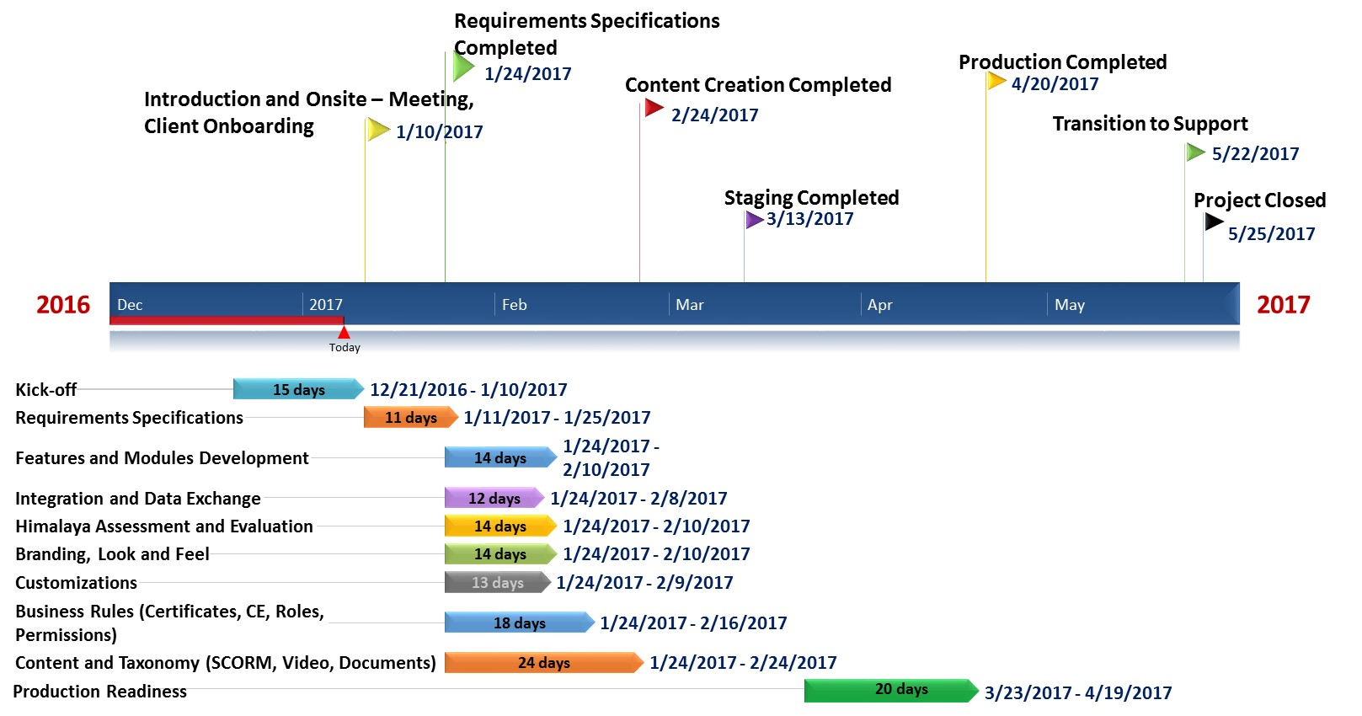
LMS Implementation Timeline

Slide 10
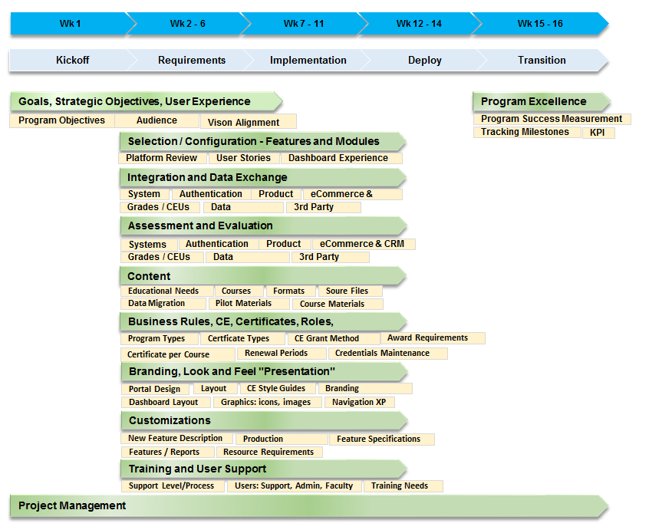
LMS Implementation PM Framework

Slide 11
LMS Project Phases
Kick-off
Introduction and Project Scope
Project Plan Defined
Requirements
Focus streams defined and documented
Statement of Work approved
Deploy
Production Readiness
Go – live
Implementation
Focus streams
executed
QA
Transition
Transition to support
30 day check-in

Slide 12
Critical Success Factors – PM Approach
Communications Path
Project Manager: PM Name
Escalation: Exec Sponsor Name
Change Management Process
Defining scope, priority and approval
Quality Assurance & Testing Approach
Use cases developed through Requirements
One list – one view
Risk Management – Identified Risk /Risk Register
Identify, flag and collaborate

Slide 13
YM Project Governance

Slide 14
Solution Identification/Fit Gap Analysis
Walkthrough of Legacy Learning Portal
Walkthrough of YM Crowd Wisdom
Solution Work Streams

Slide 15
LMS Solution Work Streams
Goals, Strategic Objectives, and User Experience desired
Selection and Configuration of features, modules
Integration and Data exchange
Assessment + Evaluations
Content
Business Rules, CEU, Certificates, Roles, Permissions
Branding + the Look & Feel
Customizations
Training and User Support
Program Excellence

Slide 16
Goals, Strategic Objectives, and UX desired

Slide 17
Selection and Configuration of features, modules

Slide 18
Integration and Data Exchange
Identify Integration Points – User Cycle
Authentication (SSO) and User Profiles
Roles and Responsibilities
Catalog and Store User Flow
Transaction Processing
Enrollment Subscriptions
Credits Earned

Slide 19
Branding – Look and Feel
General Walkthrough of advanced branding requirements (Logo & Colors)
Overall Web Presence Needs
Configuration Options
Dashboards
Widgets
Tabs
Modules

Slide 20
Content
Business Rules, CEU, Certificates
Assessments and Evaluations

Slide 21
Training and User Support
Training
User Support

Slide 22
Customizations
Specific Business Rules
Special Functionality Requirements

Slide 23
Assumptions

Slide 24
Constraints / Dependencies

Slide 25
Recap and Overview of Day 1
Review of items covered today
Review of action items for core team

Slide 26
Go-live Planning
Go-live Readiness Plan

Slide 27
Transition to Support
Transition to Support Process
Transition to Support Roles and Responsibilities
Transition to Support Acceptance Criteria
Client Support Contacts and Users
Project Closure

Slide 28
Identified Risks

Slide 29
Next Steps
Wrap Up

Slide 30
Q&A

